Slide 1



How AI can help with antibiotic
decision-making in hospitals?
Bernard Hernandez
b.hernandez-perez@imperial.ac.uk
Center for Bio-Inspired Technology
Imperial College London
3rd of November 2020
1

Slide 2
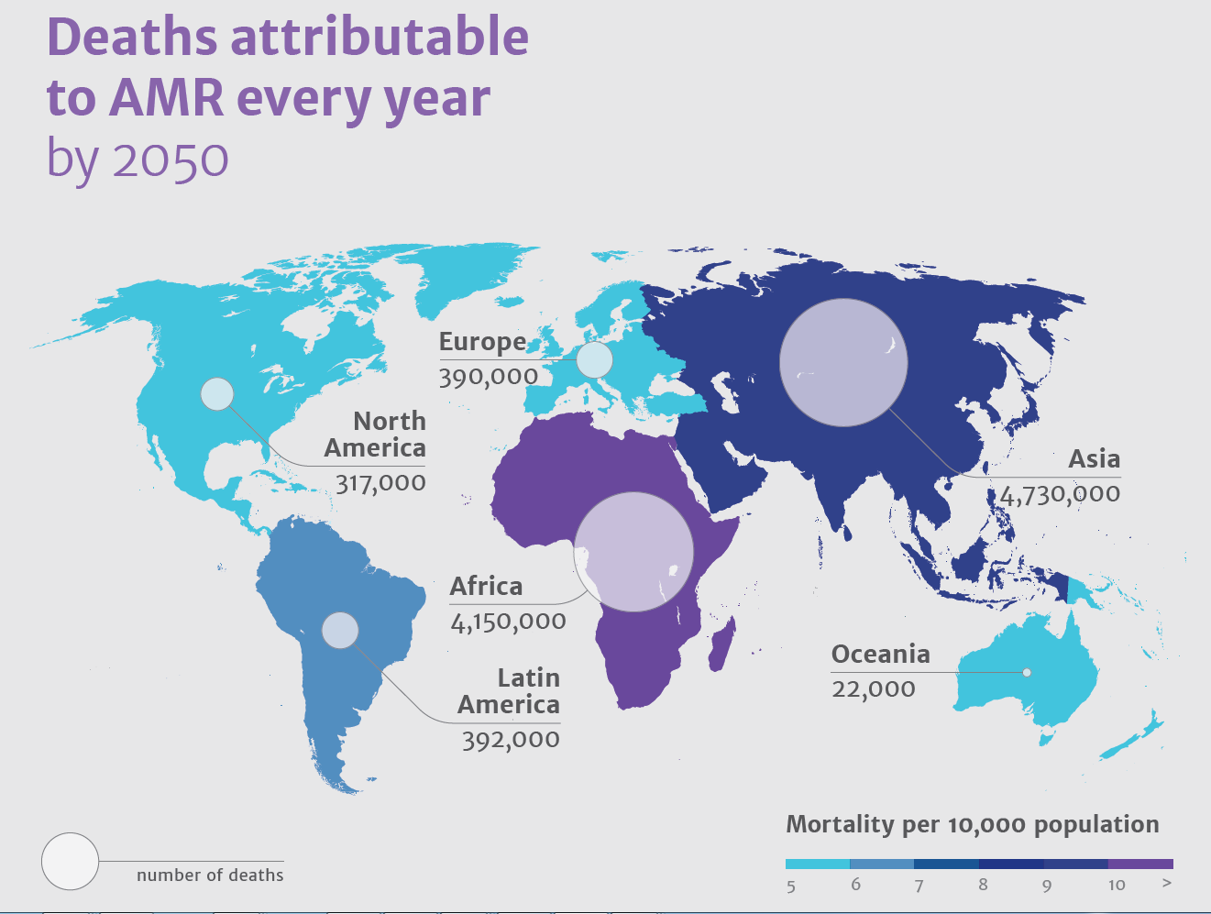
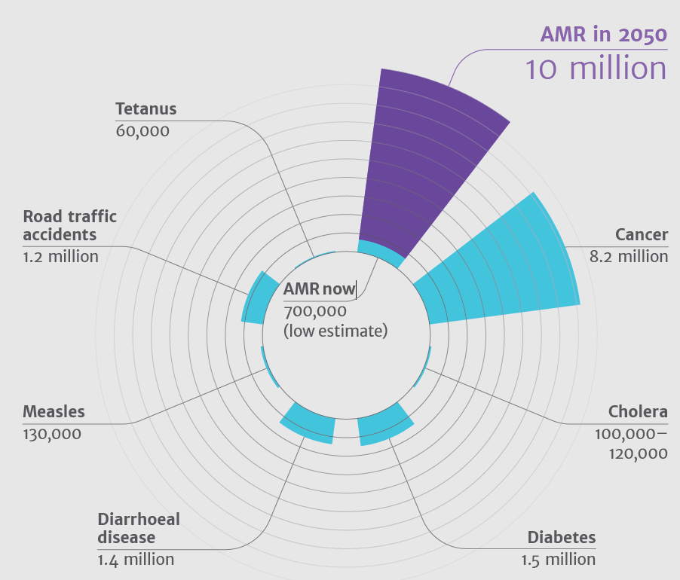
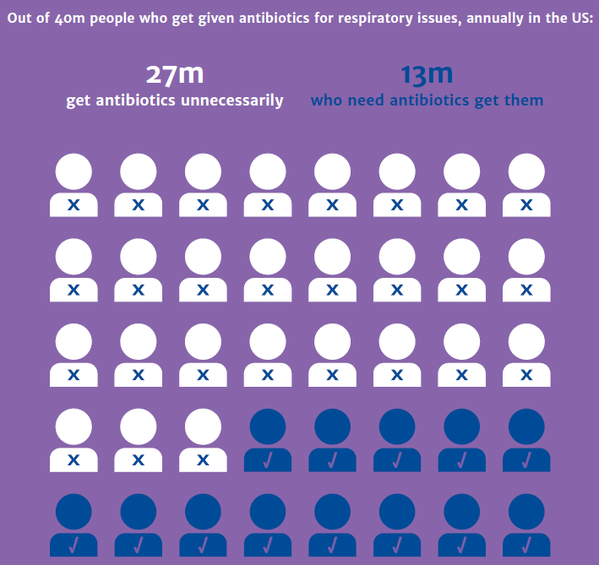
ANTIMICROBIAL RESISTANCE

Slide 3
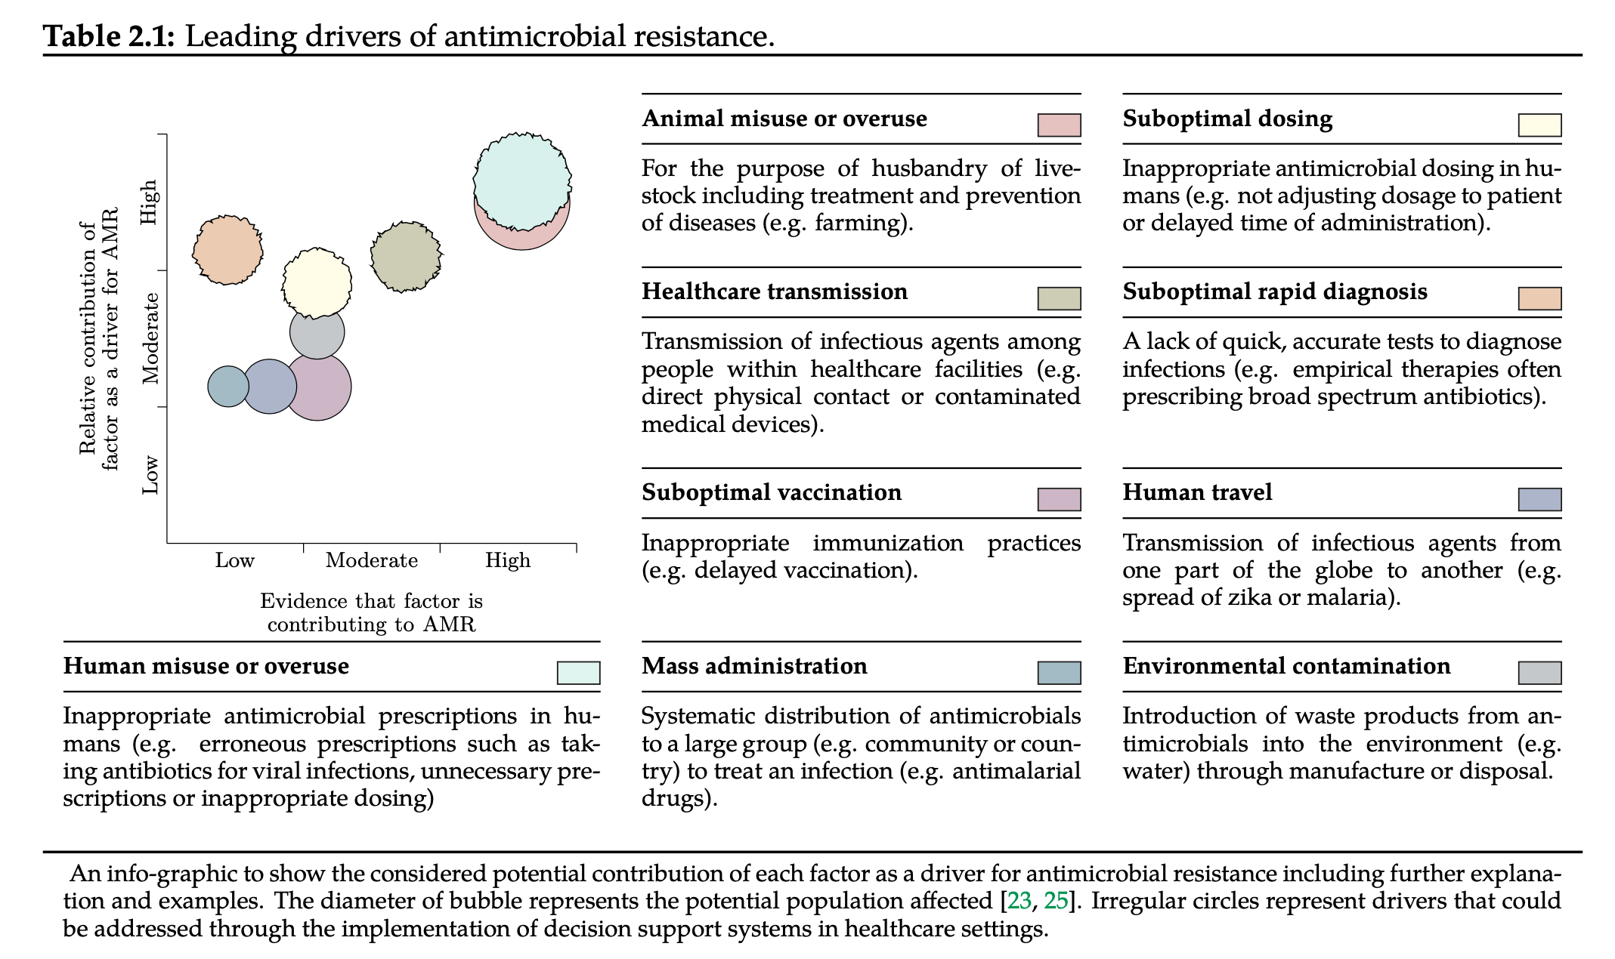
LEADING DRIVERS OF AMR
AH Holmes et al Understanding the mechanisms and drivers of AMR - The Lancet (2015)
Notes:
If we look at the leading drivers of AMR, which are shown in this picture, a major driver of AMR has been the misuse of antimicrobials in humans and up to 50% of all antimicrobials prescribed to people are considered unnecessary [28]. For instance, in the COVID-19 though the rates of detected bacterial or fungal co-infection appears to be low, the use of empirical antimicrobial therapy has been widely observed. These prescriptions are usually based on clinical educated guess and are more frequent at early stages. They also rely on the use of broad-spectrum antimicrobials hence contributing to the increasing prevalence of multi-resistant microbes [34].

Slide 4
THE INFECTION MANAGEMENT PATHWAY
Figure 7.1: Acute infection management pathway. The stepwise Bayesian like infection management pathway followed by clinicians as described in [5]. Boxes below describe parameters commonly required during such phases of the infection management pathway. Boxes above suggest methods, systems or techniques to improve data collection on such phases. The module(s) providing support on each of the steps are: case-based reasoning (CBR), probabilistic inference (PI) and antimicrobial resistance surveillance (AMR).
TM Rawson et al Mapping the decision pathways of acute infection management… – BMC Medicine (2016)

Slide 5

EPiC IMPOC - SYSTEM ARCHITECTURE
Figure 3.1: EPiC IMPOC high level system architecture diagram. It describes the main components of the CDSS. The external databases are the aptient administration system (ADMIN), pathology laboratory tests (PATH) and microbiology results (MICRO). The server application has the following modules: case-based reasoning (CBR), probabilistic inference (PI), patient engagement module, therapeutic drug monitoring and AMR surveillance. The information is accessed through an API and it is presented on hand-held computer devices or desktop computers to clinicians.
B Hernandez et al Data-driven web-based intelligent CDSS for infection management… – Health Informatics (2017)

Slide 6
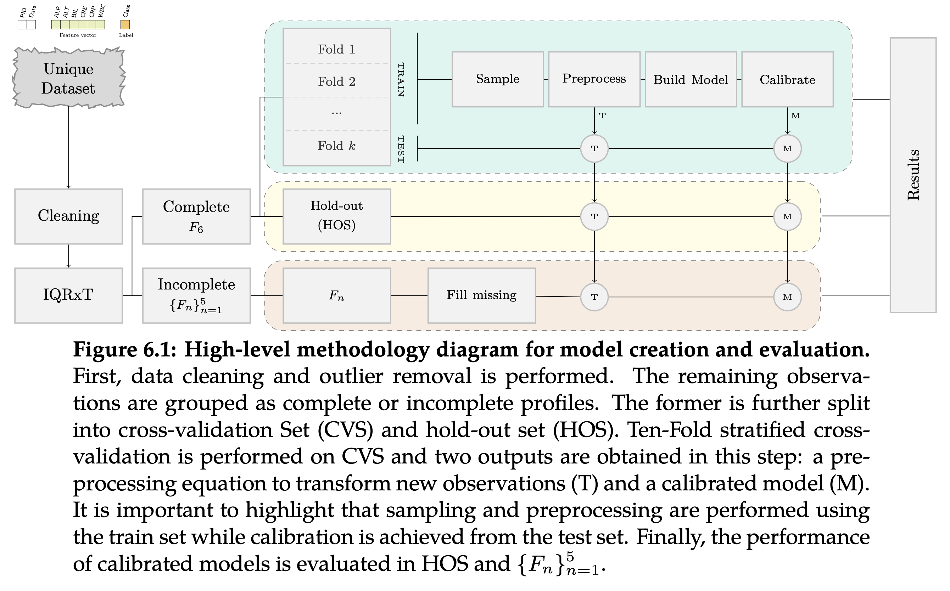
EPiC IMPOC – INFERENCE MODULE
The prospective evaluation 104 patients (35% diagnosed with infection in 72h) (42% had microbiological investigations) On day of admission AUCROC 0.84 (95% CI:0.76 – 0.91)
*
B Hernandez et al Supervised learning for infection risk… - BMC medical informatics (2017)
TM Rawson et al Supervised learning prospective study… - JAC (2019) *
B Hernandez – PhD Thesis (2019) – http://spiral.imperial.ac.uk/handle/10044/1/73000

Slide 7
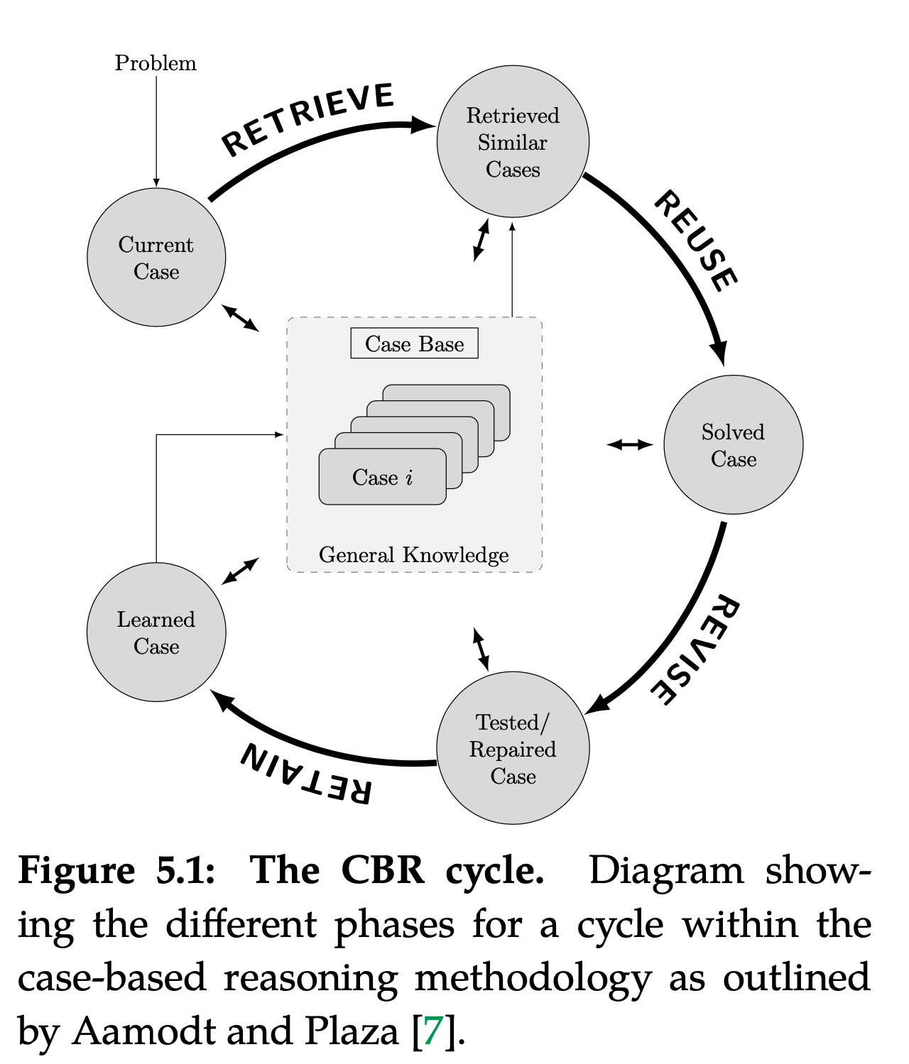
EPiC IMPOC – CBR MODULE
The E. Coli case study 145 patients (all received antibiotics) Antimicrobial Spectrum index (ASI) Physicians - 83% appropriate CBR - 90% appropriate
*
B Hernandez et al Data-driven web-based intelligent CDSS for infection management… – Health Informatics (2017)
TM Rawson et al A real-world evaluation of CBR to support antimicrobial prescribing… - CID (2020) *
Notes:
The aim of Case-Based Reasoning (CBR) is to solve new problems based on the solutions of similar past problems. And in fact, CBR aligns very well with the methodology used in clinical environments where physicians make decisions based on knowledge acquired from past cases personally experienced. As an example, lets assume that the physician has a patient in front of them (current case), then….. [keep explaining the graph]
We evaluated the system in a cohort of 145 individual patients (with all of them receiving antibiotics). In order to compare the prescriptions, we used the Antimicrobial Spectrum Index (ASI) which aims to classify agents based on activity against important pathogens. Summarising the results, 90% of the CBR recommendations were deemed appropriate based on the ASI in comparison with 83% of appropriate prescriptions made by physicians. There was no statistically significant difference between the recommendations. Note that ASI provides a metric that describes the spectrum of antimicrobial rather than simply deeming it as appropriate / inappropriate. More information can be found on the paper marked with an asterisk below.

Slide 8
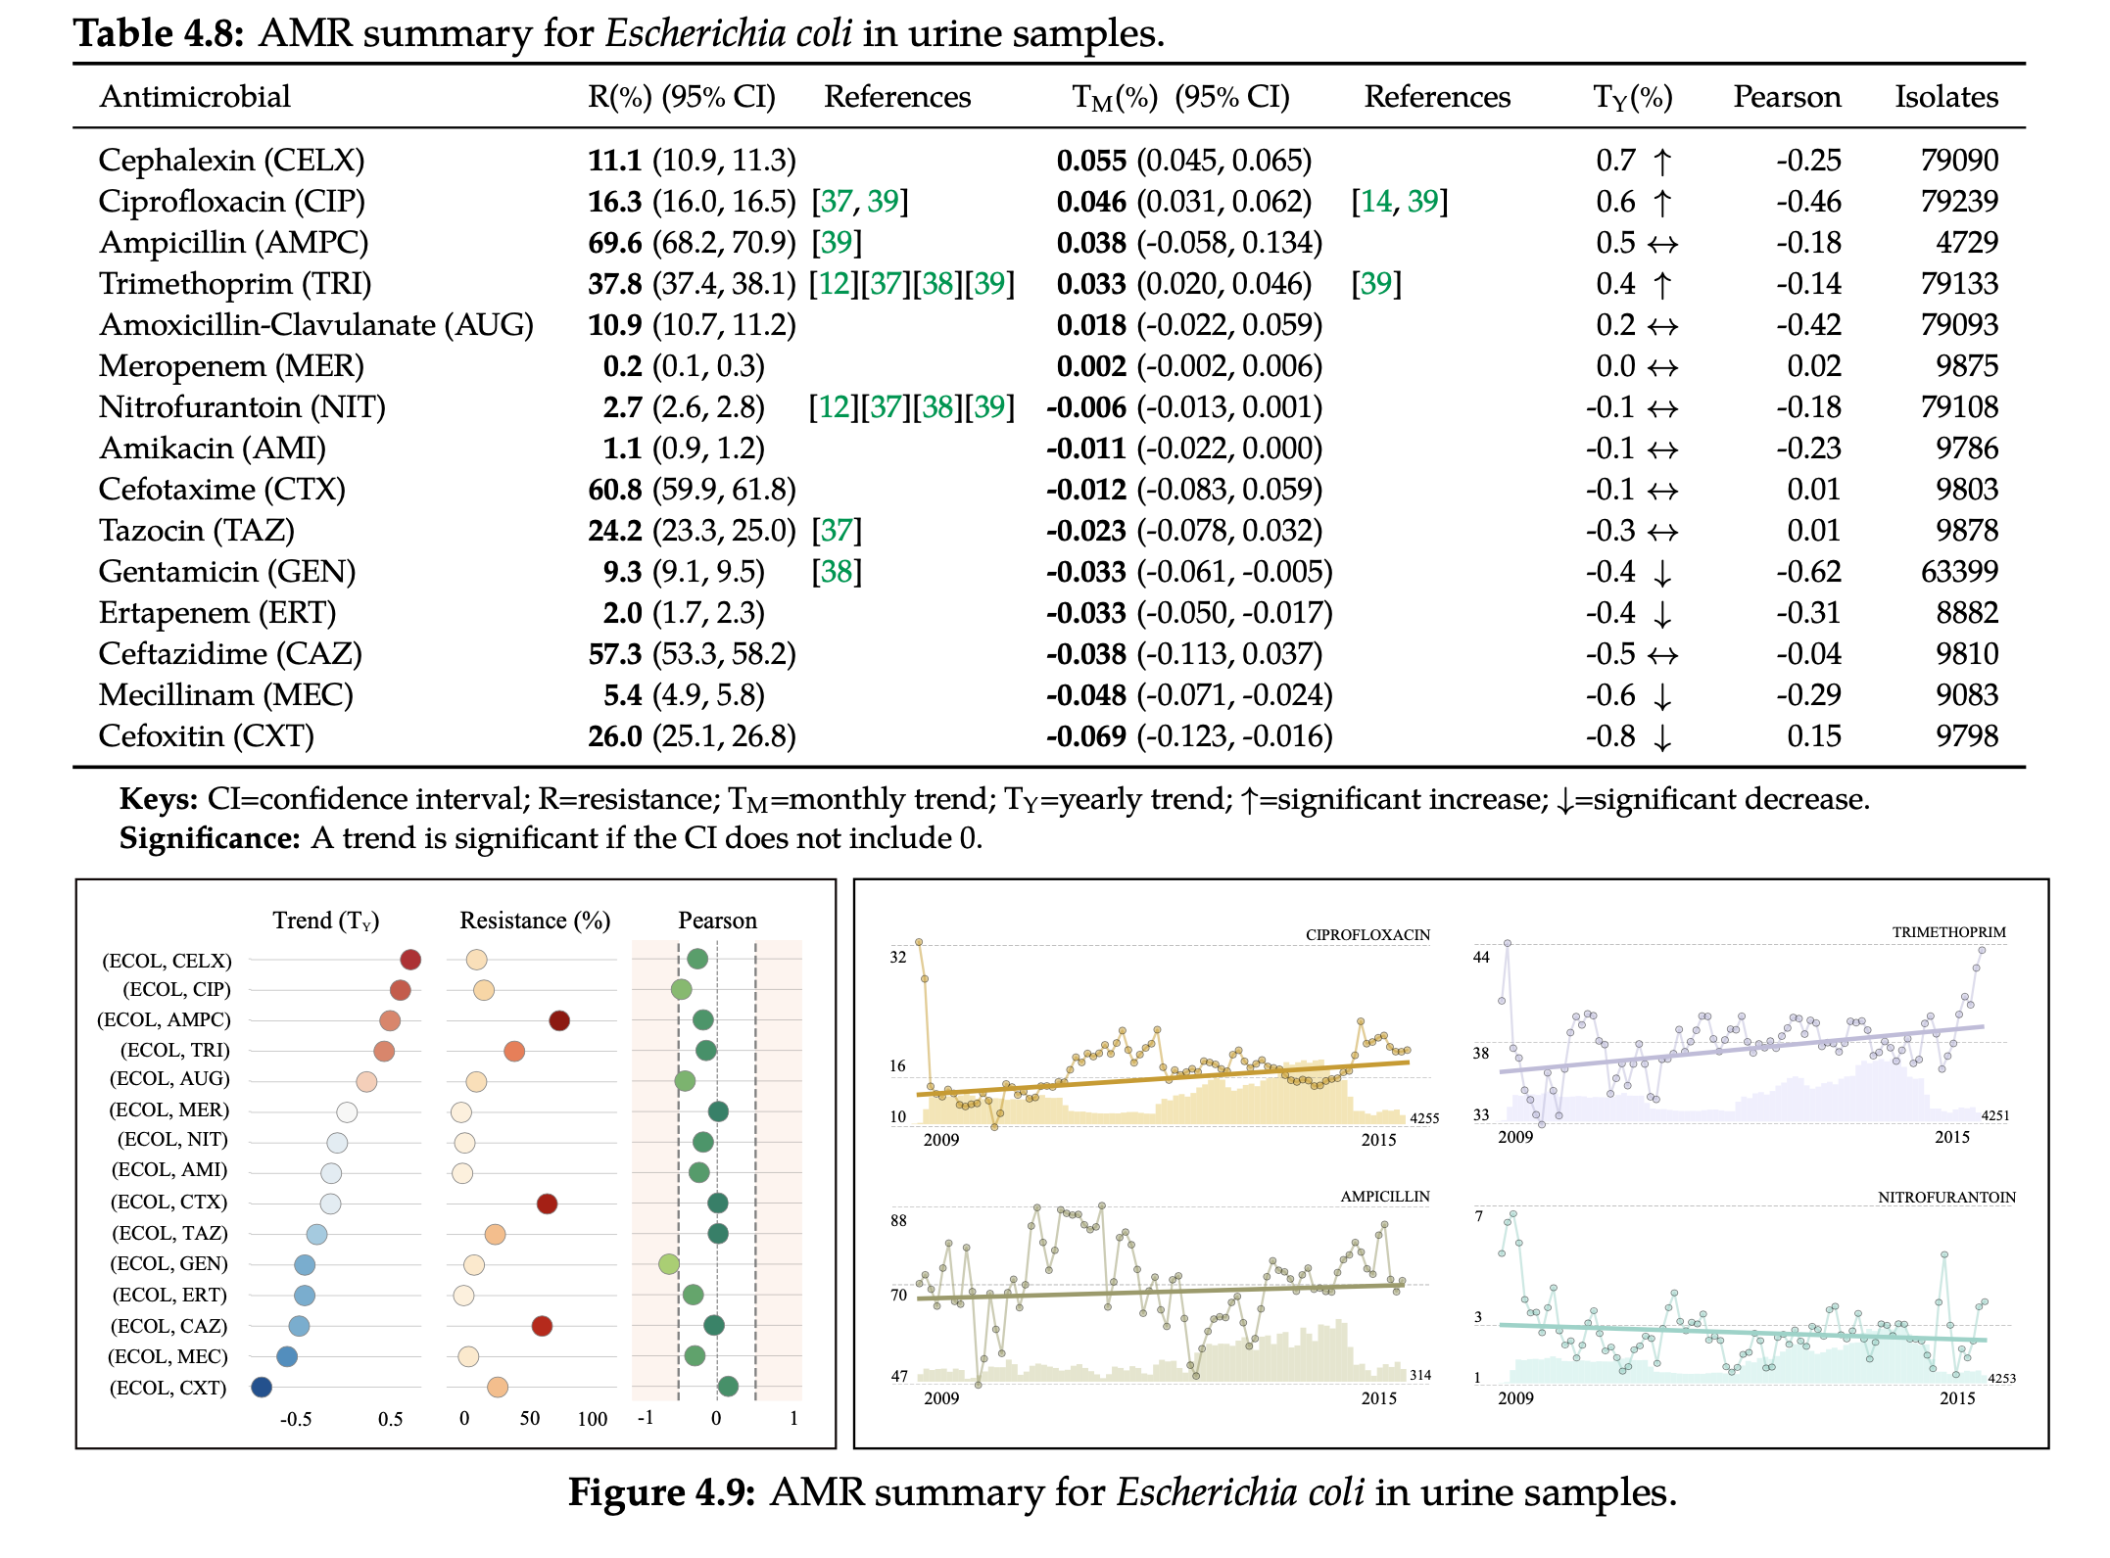
EPiC IMPOC – AMR MODULE (I)
B Hernandez – PhD Thesis (2019) – http://spiral.imperial.ac.uk/handle/10044/1/73000

Slide 9
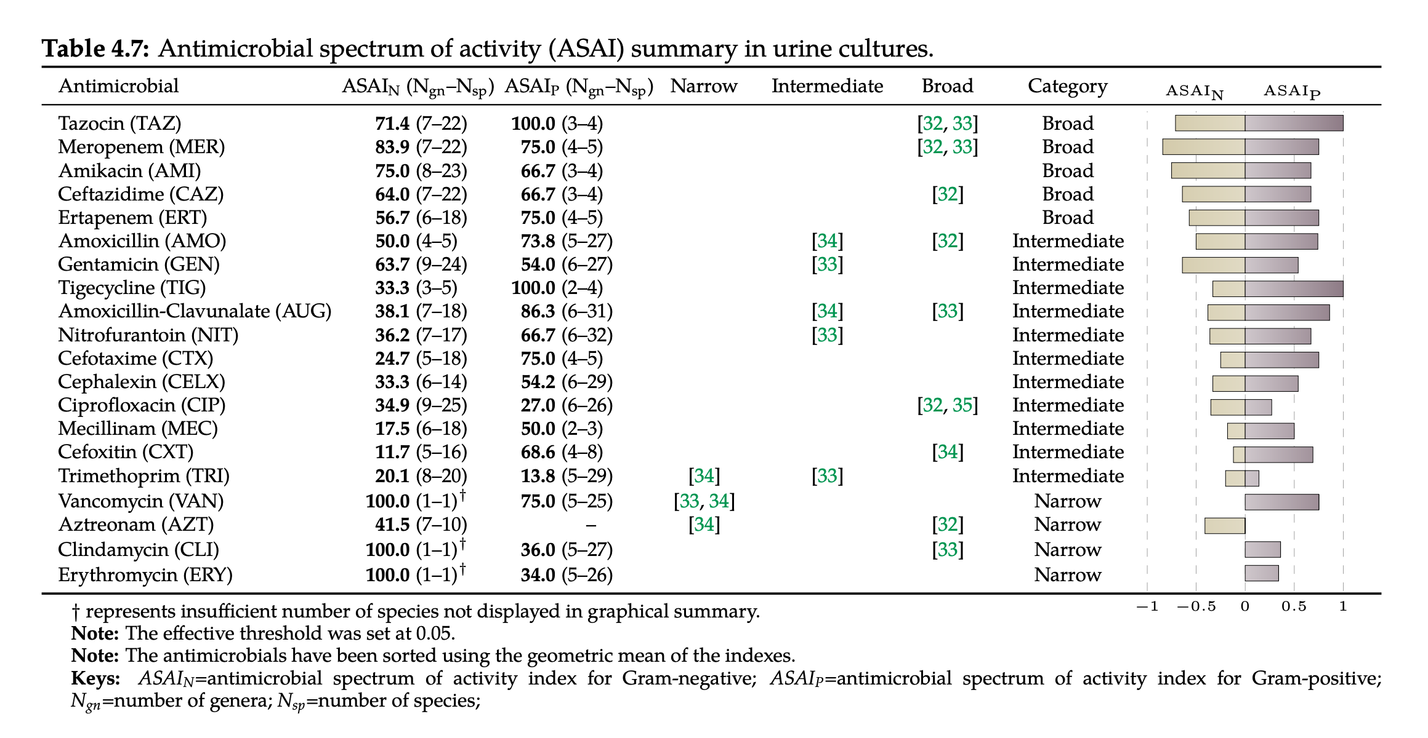
EPiC IMPOC – AMR MODULE (II)
B Hernandez – PhD Thesis (2019) – http://spiral.imperial.ac.uk/handle/10044/1/73000

Slide 10
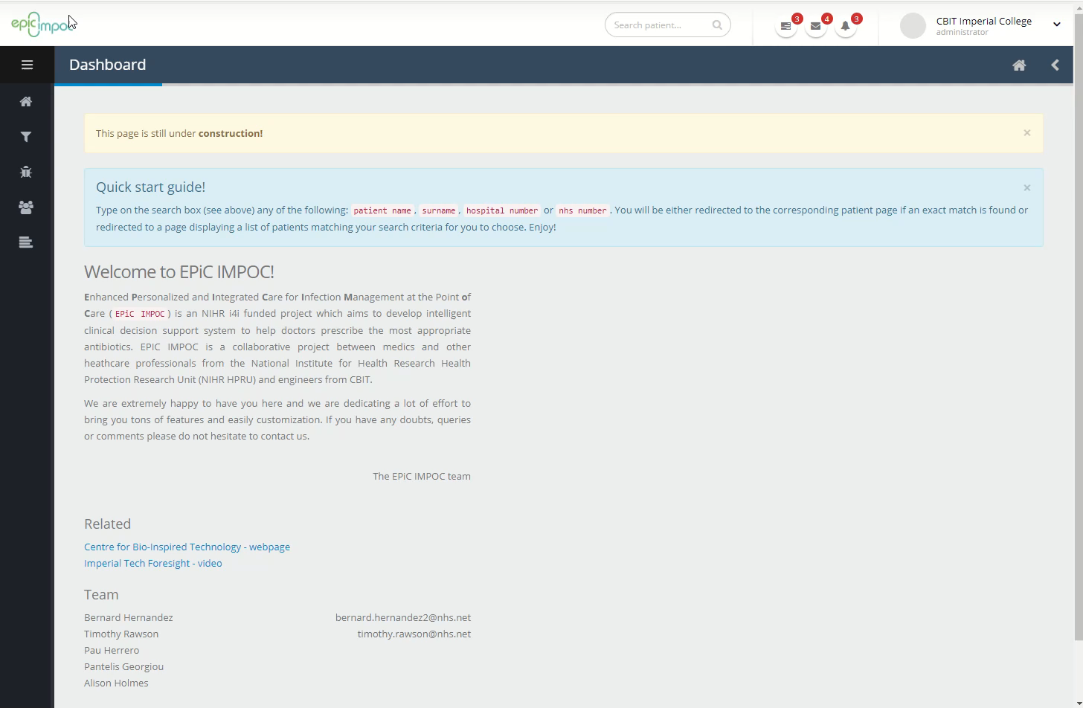
EPiC IMPOC – DEMONSTRATION

Slide 11








THE TEAM
Health Protection Research Unit in HCAI and AMR | Medicine
Centre for Bio-Inspired Technology Biomedical Engineering | EEE

Slide 12




QUESTIONS
?
Bernard Hernandez
b.hernandez-perez@imperial.ac.uk
Center for Bio-Inspired Technology
Imperial College London
3rd of November 2020
i4i
BRC
HPRU

